Slide 1
Pseudorandom Number Generation and Stream Ciphers
Notes:
An important cryptographic function is cryptographically strong pseudorandom number
generation. Pseudorandom number generators (PRNGs) are used in a variety
of cryptographic and security applications. We begin the chapter with a look at the
basic principles of PRNGs and contrast these with true random number generators
(TRNGs). Next, we look at some common PRNGs, including PRNGs based on the
use of a symmetric block cipher.
The chapter then moves on to the topic of symmetric stream ciphers, which are
based on the use of a PRNG. The chapter next examines the most important stream
cipher, RC4. Finally, we examine TRNGs.

Slide 2
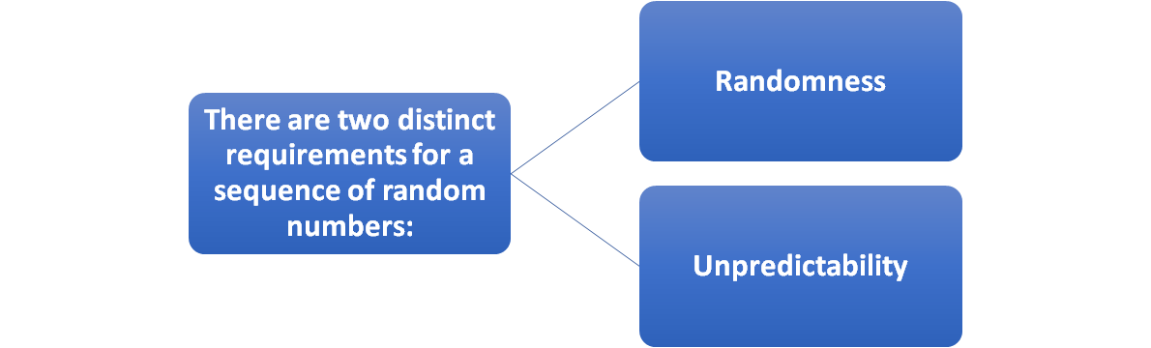
Random Numbers
A number of network security algorithms and protocols based on cryptography make use of random binary numbers:
  Key distribution and reciprocal authentication schemes
  Session key generation
  Generation of keys for the RSA public-key encryption algorithm
  Generation of a bit stream for symmetric stream encryption
Notes:
A number of network security algorithms and protocols based on cryptography
make use of random binary numbers. For example,
• Key distribution and reciprocal (mutual) authentication schemes, such as
those discussed in Chapters 14 and 15. In such schemes, two communicating
parties cooperate by exchanging messages to distribute keys and/or authenticate
each other. In many cases, nonces are used for handshaking to prevent
replay attacks. The use of random numbers for the nonces frustrates an opponent’s
efforts to determine or guess the nonce, in order to repeat an obsolete
transaction.
• Session key generation. We will see a number of protocols in this book where
a secret key for symmetric encryption is generated for use for a particular
transaction (or session) and is valid for a short period of time. This key is
generally called a session key.
• Generation of keys for the RSA public-key encryption algorithm (described
in Chapter 9).
• Generation of a bit stream for symmetric stream encryption (described in this
chapter).
These applications give rise to two distinct and not necessarily compatible
requirements for a sequence of random numbers: randomness and unpredictability.

Slide 3
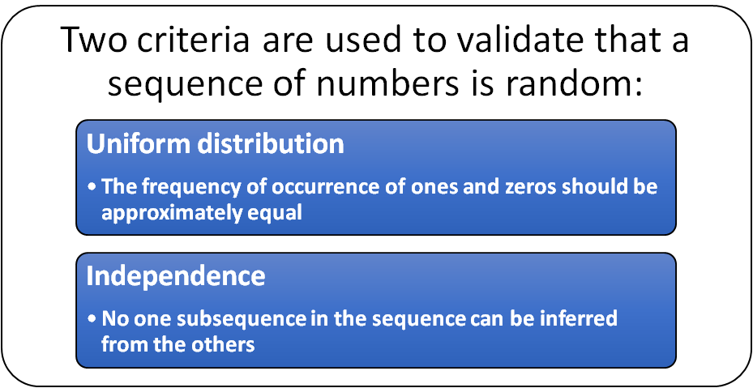
Randomness
The generation of a sequence of allegedly random numbers being random in some well-defined statistical sense has been a concern
Notes:
Traditionally, the concern in the generation of a sequence of allegedly
random numbers has been that the sequence of numbers be random in some
well-defined statistical sense. The following two criteria are used to validate that a
sequence of numbers is random:
• Uniform distribution: The distribution of bits in the sequence should be uniform;
that is, the frequency of occurrence of ones and zeros should be approximately
equal.
• Independence: No one subsequence in the sequence can be inferred from the
others.
Although there are well-defined tests for determining that a sequence of bits
matches a particular distribution, such as the uniform distribution, there is no such
test to “prove” independence. Rather, a number of tests can be applied to demonstrate
if a sequence does not exhibit independence. The general strategy is to apply
a number of such tests until the confidence that independence exists is sufficiently
strong. That is, if each of a number of tests fails to show that a sequence of bits is
not independent, then we can have a high level of confidence that the sequence is in
fact independent.

Slide 4
Unpredictability
The requirement is not just that the sequence of numbers be statistically random, but that the successive members of the sequence are unpredictable
With “true” random sequences each number is statistically independent of other numbers in the sequence and therefore unpredictable
  True random numbers have their limitations, such as inefficiency, so it is more common to implement algorithms that generate sequences of numbers that appear to be random
  Care must be taken that an opponent not be able to predict future elements of the sequence on the basis of earlier elements
Notes:
In applications such as reciprocal authentication, session key
generation, and stream ciphers, the requirement is not just that the sequence of
numbers be statistically random but that the successive members of the sequence
are unpredictable. With “true” random sequences, each number is statistically independent
of other numbers in the sequence and therefore unpredictable. Although
true random numbers are used in some applications, they have their limitations,
such as inefficiency, as is discussed shortly. Thus, it is more common to implement
algorithms that generate sequences of numbers that appear to be random. In this
latter case, care must be taken that an opponent not be able to predict future elements
of the sequence on the basis of earlier elements.

Slide 5
Pseudorandom Numbers
Cryptographic applications typically make use of algorithmic techniques for random number generation
These algorithms are deterministic and therefore produce sequences of numbers that are not statistically random
If the algorithm is good, the resulting sequences will pass many tests of randomness and are referred to as pseudorandom numbers
Notes:
Cryptographic applications typically make use of algorithmic techniques for random
number generation. These algorithms are deterministic and therefore produce
sequences of numbers that are not statistically random. However, if the algorithm is
good, the resulting sequences will pass many tests of randomness. Such numbers are
referred to as pseudorandom numbers .

Slide 6
True Random Number Generator (TRNG)
Takes as input a source that is effectively random
The source is referred to as an entropy source and is drawn from the physical environment of the computer
  Includes things such as keystroke timing patterns, disk electrical activity, mouse movements, and instantaneous values of the system clock
  The source, or combination of sources, serve as input to an algorithm that produces random binary output
  The TRNG may simply involve conversion of an analog source to a binary output
  The TRNG may involve additional processing to overcome any bias in the source
Notes:
A TRNG takes as input a source that is effectively
random; the source is often referred to as an entropy source.
In essence, the entropy source is drawn from the physical
environment of the computer and could include things such as keystroke timing
patterns, disk electrical activity, mouse movements, and instantaneous values of the
system clock.
The source, or combination of sources, serve as input to an algorithm
that produces random binary output. The TRNG may simply involve conversion of
an analog source to a binary output. The TRNG may involve additional processing
to overcome any bias in the source; this is discussed in Section 7.6.

Slide 7
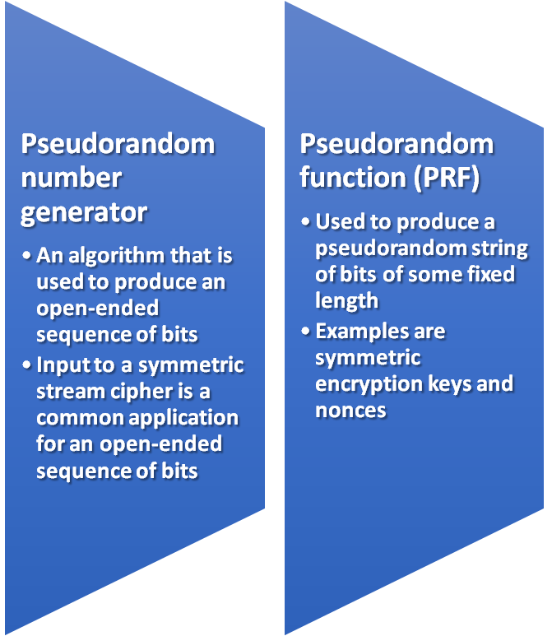
Pseudorandom Number Generator (PRNG)
Takes as input a fixed value, called the seed, and produces a sequence of output bits using a deterministic algorithm
  Quite often the seed is generated by a TRNG
The output bit stream is determined solely by the input value or values, so an adversary who knows the algorithm and the seed can reproduce the entire bit stream
    Other than the number of bits produced there is no difference between a PRNG and a PRF
Two different forms of PRNG
Notes:
In contrast, a PRNG takes as input a fixed value, called the seed , and produces
a sequence of output bits using a deterministic algorithm. Quite often, the seed is
generated by a TRNG. Typically, as shown, there is some feedback path by which
some of the results of the algorithm are fed back as input as additional output bits
are produced. The important thing to note is that the output bit stream is determined
solely by the input value or values, so that an adversary who knows the algorithm
and the seed can reproduce the entire bit stream.
Figure 7.1 shows two different forms of PRNGs, based on application.
• Pseudorandom number generator: An algorithm that is used to produce an
open-ended sequence of bits is referred to as a PRNG. A common application
for an open-ended sequence of bits is as input to a symmetric stream cipher, as
discussed in Section 7.4. Also, see Figure 3.1a.
• Pseudorandom function (PRF): A PRF is used to produced a pseudorandom
string of bits of some fixed length. Examples are symmetric encryption keys
and nonces. Typically, the PRF takes as input a seed plus some context specific
values, such as a user ID or an application ID. A number of examples of
PRFs will be seen throughout this book, notably in Chapters 17 and 18.
Other than the number of bits produced, there is no difference between a PRNG
and a PRF. The same algorithms can be used in both applications. Both require a seed
and both must exhibit randomness and unpredictability. Further, a PRNG application
may also employ context-specific input. In what follows, we make no distinction
between these two applications.

Slide 8
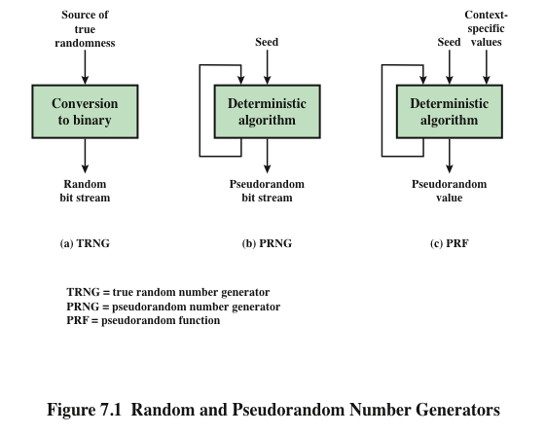
Notes:
Figure 7.1 contrasts a true random number generator (TRNG) with two forms
of pseudorandom number generators.

Slide 9

PRNG Requirements
The basic requirement when a PRNG or PRF is used for a cryptographic application is that an adversary who does not know the seed is unable to determine the pseudorandom string
The requirement for secrecy of the output of a PRNG or PRF leads to specific requirements in the areas of:
  Randomness
  Unpredictability
  Characteristics of the seed
Notes:
When a PRNG or PRF is used for a cryptographic application, then the basic
requirement
is that an adversary who does not know the seed is unable to determine
the pseudorandom string. For example, if the pseudorandom bit stream is
used in a stream cipher, then knowledge of the pseudorandom bit stream would
enable the adversary to recover the plaintext from the ciphertext. Similarly, we
wish to protect the output value of a PRF. In this latter case, consider the following
scenario. A 128-bit seed, together with some context-specific values, are used
to generate a 128-bit secret key that is subsequently used for symmetric encryption.
Under normal circumstances, a 128-bit key is safe from a brute-force attack.
However, if the PRF does not generate effectively random 128-bit output values,
it may be possible for an adversary to narrow the possibilities and successfully use
a brute force attack.
This general requirement for secrecy of the output of a PRNG or PRF leads to
specific requirements in the areas of randomness, unpredictability, and the characteristics
of the seed. We now look at these in turn.

Slide 10

Randomness
The generated bit stream needs to appear random even though it is deterministic
There is no single test that can determine if a PRNG generates numbers that have the characteristic of randomness
  If the PRNG exhibits randomness on the basis of multiple tests, then it can be assumed to satisfy the randomness requirement
NIST SP 800-22 specifies that the tests should seek to establish three characteristics:
  Uniformity
  Scalability
  Consistency
Notes:
In terms of randomness, the requirement for a PRNG is that the generated
bit stream appear random even though it is deterministic. There is no single
test that can determine if a PRNG generates numbers that have the characteristic
of randomness. The best that can be done is to apply a sequence of tests to the
PRNG. If the PRNG exhibits randomness on the basis of multiple tests, then it can
be assumed to satisfy the randomness requirement. NIST SP 800-22 (A Statistical
Test Suite for Random and Pseudorandom Number Generators for Cryptographic
Applications ) specifies that the tests should seek to establish the following three
characteristics.
• Uniformity: At any point in the generation of a sequence of random or pseudorandom
bits, the occurrence of a zero or one is equally likely, i.e., the probability
of each is exactly 1/2. The expected number of zeros (or ones) is n /2,
where n = the sequence length.
• Scalability: Any test applicable to a sequence can also be applied to subsequences
extracted at random. If a sequence is random, then any such extracted
subsequence should also be random. Hence, any extracted subsequence
should pass any test for randomness.
• Consistency: The behavior of a generator must be consistent across starting
values (seeds). It is inadequate to test a PRNG based on the output from a
single seed or an TRNG on the basis of an output produced from a single
physical output.

Slide 11
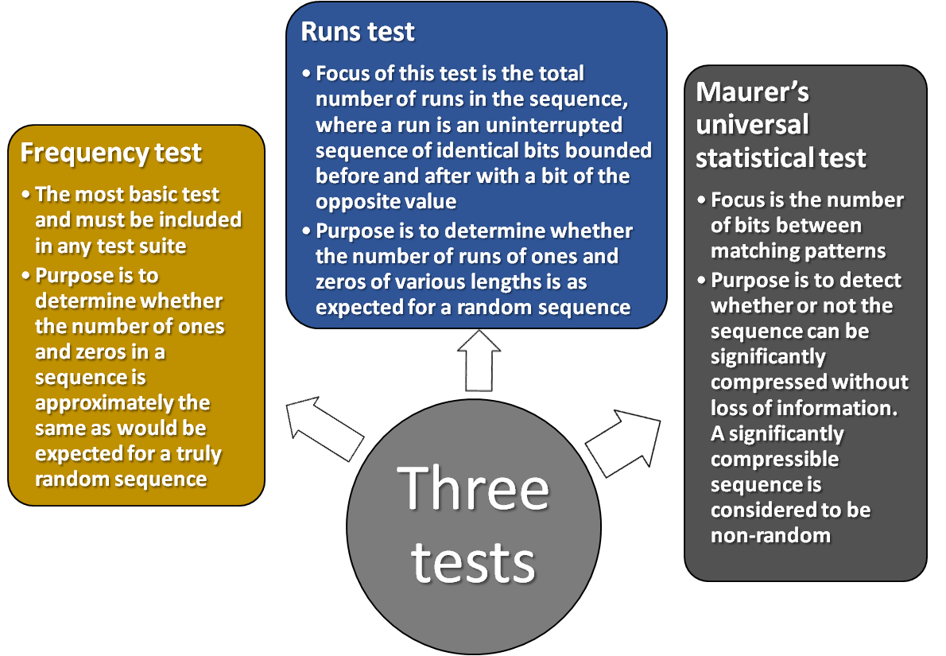
Randomness Tests
SP 800-22 lists 15 separate tests of randomness
Notes:
SP 800-22 lists 15 separate tests of randomness. An understanding of these
tests requires a basic knowledge of statistical analysis, so we don’t attempt a
technical description here. Instead, to give some flavor for the tests, we list three of
the tests and the purpose of each test, as follows.
• Frequency test: This is the most basic test and must be included in any test
suite. The purpose of this test is to determine whether the number of ones and
zeros in a sequence is approximately the same as would be expected for a truly
random sequence.
• Runs test: The focus of this test is the total number of runs in the sequence,
where a run is an uninterrupted sequence of identical bits bounded before
and after with a bit of the opposite value. The purpose of the runs test is to
determine whether the number of runs of ones and zeros of various lengths is
as expected for a random sequence.
• Maurer’s universal statistical test: The focus of this test is the number of bits
between matching patterns (a measure that is related to the length of a compressed
sequence). The purpose of the test is to detect whether or not the
sequence can be significantly compressed without loss of information. A significantly
compressible sequence is considered to be non-random.

Slide 12
Unpredictability
A stream of pseudorandom numbers should exhibit two forms of unpredictability:
Forward unpredictability
  If the seed is unknown, the next output bit in the sequence should be unpredictable in spite of any knowledge of previous bits in the sequence
Backward unpredictability
  It should not be feasible to determine the seed from knowledge of any generated values. No correlation between a seed and any value generated from that seed should be evident; each element of the sequence should appear to be the outcome of an independent random event whose probability is 1/2
The same set of tests for randomness also provides a test of unpredictability
  A random sequence will have no correlation with a fixed value (the seed)
Notes:
A stream of pseudorandom numbers should exhibit two forms
of unpredictability:
• Forward unpredictability : If the seed is unknown, the next output bit in the
sequence should be unpredictable in spite of any knowledge of previous bits in
the sequence.
• Backward unpredictability : It should also not be feasible to determine the
seed from knowledge of any generated values. No correlation between a seed
and any value generated from that seed should be evident; each element of the
sequence should appear to be the outcome of an independent random event
whose probability is 1/2.
The same set of tests for randomness also provide a test of unpredictability. If the
generated bit stream appears random, then it is not possible to predict some bit or bit
sequence from knowledge of any previous bits. Similarly, if the bit sequence appears
random, then there is no feasible way to deduce the seed based on the bit sequence.
That is, a random sequence will have no correlation with a fixed value (the seed).

Slide 13

Seed Requirements
The seed that serves as input to the PRNG must be secure and unpredictable
The seed itself must be a random or pseudorandom number
Typically the seed is generated by TRNG
Notes:
For cryptographic applications, the seed that serves as input to
the PRNG must be secure. Because the PRNG is a deterministic algorithm, if the
adversary can deduce the seed, then the output can also be determined. Therefore,
the seed must be unpredictable. In fact, the seed itself must be a random or pseudorandom
number.

Slide 14
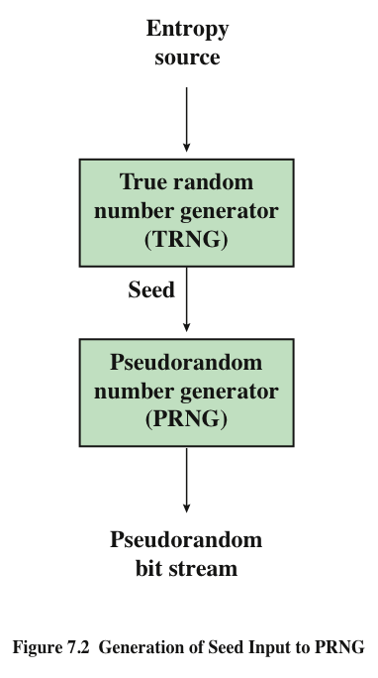
Generation of
Seed
Input to
PRNG
Notes:
Typically, the seed is generated by a TRNG, as shown in Figure 7.2. This is the
scheme recommended by SP800-90. The reader may wonder, if a TRNG is available,
why it is necessary to use a PRNG. If the application is a stream cipher, then
a TRNG is not practical. The sender would need to generate a keystream of bits as
long as the plaintext and then transmit the keystream and the ciphertext securely to
the receiver. If a PRNG is used, the sender need only find a way to deliver the stream
cipher key, which is typically 54 or 128 bits, to the receiver in a secure fashion.
Even in the case of a PRF application, in which only a limited number of bits
is generated, it is generally desirable to use a TRNG to provide the seed to the
PRF and use the PRF output rather than use the TRNG directly. As is explained
in Section 7.6, a TRNG may produce a binary string with some bias. The PRF
would have the effect of “randomizing” the output of the TRNG so as to eliminate
that bias.
Finally, the mechanism used to generate true random numbers may not be
able to generate bits at a rate sufficient to keep up with the application requiring
the random bits.

Slide 15
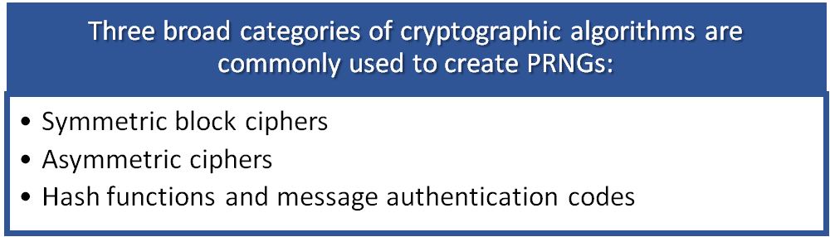
Algorithm Design
Algorithms fall into two categories:
  Purpose-built algorithms
    Algorithms designed specifically and solely for the purpose of generating pseudorandom bit streams
  Algorithms based on existing cryptographic algorithms
    Have the effect of randomizing input data
Notes:
Cryptographic PRNGs have been the subject of much research over the years,
and a wide variety of algorithms have been developed. These fall roughly into two
categories.
• Purpose-built algorithms: These are algorithms designed specifically and
solely for the purpose of generating pseudorandom bit streams. Some of these
algorithms are used for a variety of PRNG applications; several of these are
described in the next section. Others are designed specifically for use in a
stream cipher. The most important example of the latter is RC4, described in
Section 7.5.
• Algorithms based on existing cryptographic algorithms: Cryptographic algorithms
have the effect of randomizing input data. Indeed, this is a requirement
of such algorithms. For example, if a symmetric block cipher produced
ciphertext that had certain regular patterns in it, it would aid in the process of
cryptanalysis. Thus, cryptographic algorithms can serve as the core of PRNGs.
Three broad categories of cryptographic algorithms are commonly used to
create PRNGs:
—Symmetric block ciphers: This approach is discussed in Section 7.3.
—Asymmetric ciphers: The number theoretic concepts used for an asymmetric
cipher can also be adapted for a PRNG; this approach is examined in
Chapter 10.
—Hash functions and message authentication codes: This approach is examined
in Chapter 12.
Any of these approaches can yield a cryptographically strong PRNG.
A purpose-built algorithm may be provided by an operating system for general use.
For applications that already use certain cryptographic algorithms for encryption
or authentication, it makes sense to reuse the same code for the PRNG. Thus, all of
these approaches are in common use.

Slide 16
Linear Congruential Generator Parameters
An algorithm first proposed by Lehmer that is parameterized with four numbers:
m the modulus m > 0
a the multiplier 0 < a< m
c the increment 0≤ c < m
X₀ the starting value, or seed 0 ≤ X₀ < m
The sequence of random numbers {X_{n}} is obtained via the following iterative equation:
X_{n+1} = (aX_{n} + c) mod m
If m , a , c , and X₀ are integers, then this technique will produce a sequence of integers with each integer in the range 0 ≤ X_{n} < m
The selection of values for a , c , and m is critical in developing a good random number generator
Notes:
A widely used technique for pseudorandom number generation is an algorithm first
proposed by Lehmer [LEHM51], which is known as the linear congruential method.
The algorithm is parameterized with four numbers, as follows:
m the modulus m > 0
a the multiplier 0 < a< m
c the increment 0≤ c < m
X₀ the starting value, or seed 0 ≤ X₀ < m
The sequence of random numbers {X_{n}} is obtained via the following iterative equation:
X_{n+1} = (aX_{n} + c) mod m
If m , a , c , and X₀ are integers, then this technique will produce a sequence of integers
with each integer in the range 0 ≤ X_{n} < m .
The selection of values for a , c , and m is critical in developing a good random
number generator.
We would like m to be very large, so that there is the potential for producing
a long series of distinct random numbers. A common criterion is that m be nearly
equal to the maximum representable nonnegative integer for a given computer.
Thus, a value of m near to or equal to 231 is typically chosen.

Slide 17
PRNG Using Block Cipher Modes of Operation
Two approaches that use a block cipher to build a PNRG have gained widespread acceptance:
  CTR mode (Counter )
  Counter mode turns a block cipher into a stream cipher. It generates the next keystream block by encrypting successive values of a "counter". The counter can be any function which produces a sequence which is guaranteed not to repeat for a long time, although an actual increment-by-one counter is the simplest and most popular.
    Recommended in NIST SP 800-90, ANSI standard X.82, and RFC 4086
  OFB mode(Output Feedback)
  The Output Feedback (OFB) mode makes a block cipher into a synchronous stream cipher. It generates keystream blocks, which are then XORed with the plaintext blocks to get the ciphertext.
    Recommended in X9.82 and RFC 4086
Notes:
Two approaches that use a block cipher to build a PNRG have gained widespread
acceptance: the CTR mode and the OFB mode. The CTR mode is recommended in
NIST SP 800-90, in the ANSI standard X9.82 (Random Number Generation ), and in
RFC 4086. The OFB mode is recommended in X9.82 and RFC 4086.

Slide 18
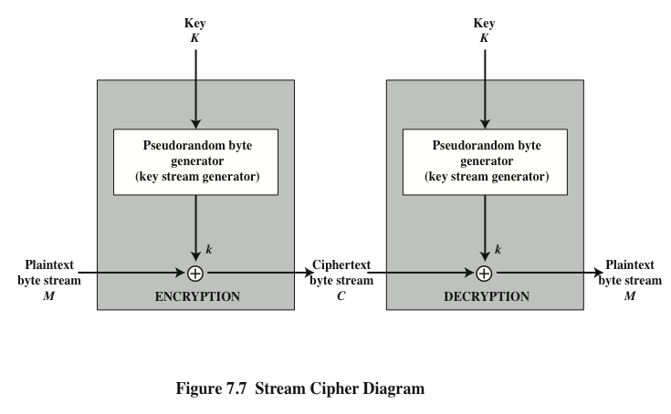
Stream Ciphers
Notes:
A typical stream cipher encrypts plaintext one byte at a time, although a stream
cipher may be designed to operate on one bit at a time or on units larger than a byte
at a time. Figure 7.7 is a representative diagram of stream cipher structure. In this
structure, a key is input to a pseudorandom bit generator that produces a stream
of 8-bit numbers that are apparently random. The output of the generator, called
a keystream , is combined one byte at a time with the plaintext stream using the
bitwise exclusive-OR (XOR) operation.

Slide 19
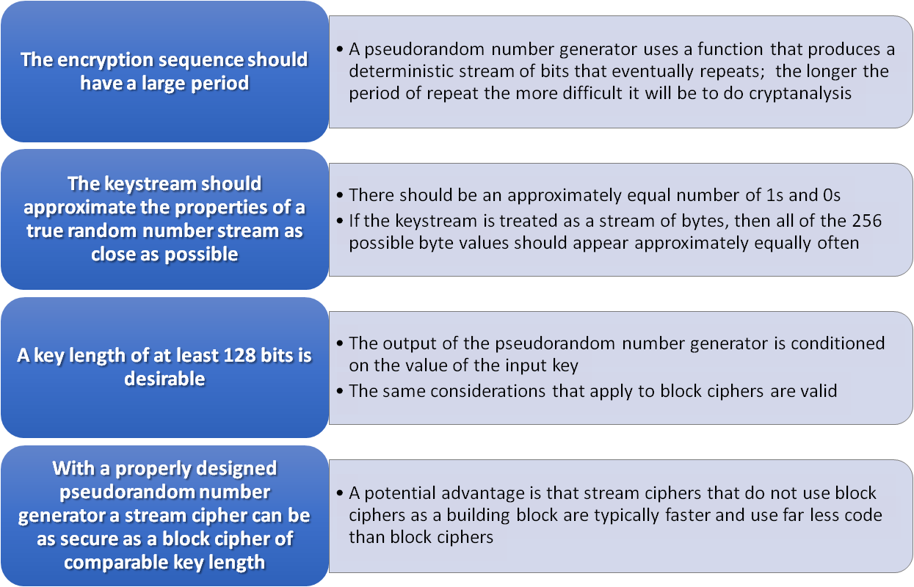
Stream Cipher Design Considerations
Notes:
The stream cipher is similar to the one-time pad discussed in Chapter 2. The
difference is that a one-time pad uses a genuine random number stream, whereas a
stream cipher uses a pseudorandom number stream.
[KUMA97] lists the following important design considerations for a stream cipher.
1. The encryption sequence should have a large period. A pseudorandom number
generator uses a function that produces a deterministic stream of bits that
eventually repeats. The longer the period of repeat the more difficult it will
be to do cryptanalysis. This is essentially the same consideration that was discussed
with reference to the Vigenère cipher, namely that the longer the keyword
the more difficult the cryptanalysis.
2. The keystream should approximate the properties of a true random number
stream as close as possible. For example, there should be an approximately
equal number of 1s and 0s. If the keystream is treated as a stream of bytes,
then all of the 256 possible byte values should appear approximately equally
often. The more random-appearing the keystream is, the more randomized the
ciphertext is, making cryptanalysis more difficult.
3. Note from Figure 7.7 that the output of the pseudorandom number generator
is conditioned on the value of the input key. To guard against brute-force
attacks, the key needs to be sufficiently long. The same considerations that
apply to block ciphers are valid here. Thus, with current technology, a key
length of at least 128 bits is desirable.
With a properly designed pseudorandom number generator, a stream cipher
can be as secure as a block cipher of comparable key length. A potential advantage
of a stream cipher is that stream ciphers that do not use block ciphers as a building
block are typically faster and use far less code than do block ciphers. The example
in this chapter, RC4, can be implemented in just a few lines of code. In recent years,
this advantage has diminished with the introduction of AES, which is quite efficient
in software. Furthermore, hardware acceleration techniques are now available for
AES. For example, the Intel AES Instruction Set has machine instructions for one
round of encryption and decryption and key generation. Using the hardware instructions
results in speedups of about an order of magnitude compared to pure
software implementations [XU10].
One advantage of a block cipher is that you can reuse keys. In contrast, if two
plaintexts are encrypted with the same key using a stream cipher, then cryptanalysis
is often quite simple [DAWS96]. If the two ciphertext streams are XORed together,
the result is the XOR of the original plaintexts. If the plaintexts are text strings,
credit card numbers, or other byte streams with known properties, then cryptanalysis
may be successful.
For applications that require encryption/decryption of a stream of data, such as
over a data communications channel or a browser/Web link, a stream cipher might
be the better alternative. For applications that deal with blocks of data, such as file
transfer, e-mail, and database, block ciphers may be more appropriate. However,
either type of cipher can be used in virtually any application.
A stream cipher can be constructed with any cryptographically strong PRNG,
such as the ones discussed in Sections 7.2 and 7.3. In the next section, we look at a
stream cipher that uses a PRNG designed specifically for the stream cipher.

Slide 20
Entropy Sources
A true random number generator (TRNG) uses a nondeterministic source to produce randomness
Most operate by measuring unpredictable natural processes such as pulse detectors of ionizing radiation events, gas discharge tubes, and leaky capacitors
Intel has developed a commercially available chip that samples thermal noise by amplifying the voltage measured across undriven resistors
LavaRnd is an open source project for creating truly random numbers using inexpensive cameras, open source code, and inexpensive hardware
  The system uses a saturated CCD in a light-tight can as a chaotic source to produce the seed; software processes the result into truly random numbers in a variety of formats
Notes:
A true random number generator (TRNG) uses a nondeterministic source to
produce randomness. Most operate by measuring unpredictable natural processes,
such as pulse detectors of ionizing radiation events, gas discharge tubes,
and leaky capacitors. Intel has developed a commercially available chip that samples
thermal noise by amplifying the voltage measured across undriven resistors
[JUN99]. LavaRnd is an open source project for creating truly random numbers
using inexpensive cameras, open source code, and inexpensive hardware. The
system uses a saturated CCD in a light-tight can as a chaotic source to produce
the seed. Software processes the result into truly random numbers in a variety of
formats.

Slide 21
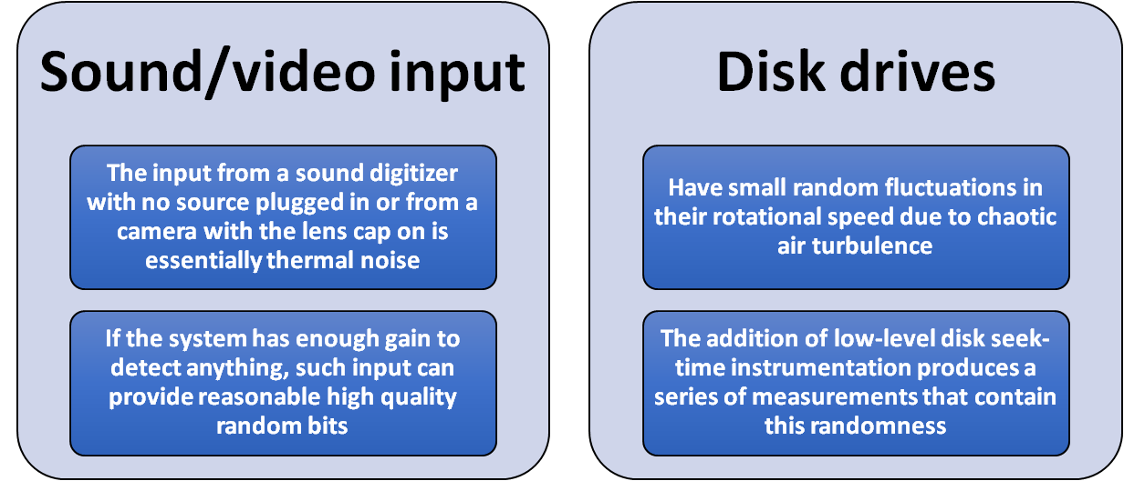
Possible Sources of Randomness
RFC 4086 lists the following possible sources of randomness that can be used on a computer to generate true random sequences:
  There is also an online service (random.org) which can deliver random sequences securely over the Internet
Notes:
RFC 4086 lists the following possible sources of randomness that, with care,
easily can be used on a computer to generate true random sequences.
• Sound/video input: Many computers are built with inputs that digitize some
real-world analog source, such as sound from a microphone or video input
from a camera. The “input” from a sound digitizer with no source plugged
in or from a camera with the lens cap on is essentially thermal noise. If the
system has enough gain to detect anything, such input can provide reasonably
high quality random bits.
• Disk drives: Disk drives have small random fluctuations in their rotational
speed due to chaotic air turbulence [JAKO98]. The addition of low-level disk
seek-time instrumentation produces a series of measurements that contain
this randomness. Such data is usually highly correlated, so significant processing
is needed. Nevertheless, experimentation a decade ago showed that, with
such processing, even slow disk drives on the slower computers of that day
could easily produce 100 bits a minute or more of excellent random data.
There is also an online service (random.org), which can deliver random
sequences securely over the Internet.

Slide 22
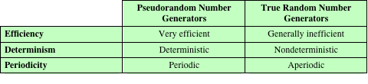
Table 7.5
Comparison of PRNGs and TRNGs
Notes:
Table 7.5 summarizes the principal differences between PRNGs and TRNGs.
PRNGs are efficient, meaning they can produce many numbers in a short time, and
deterministic, meaning that a given sequence of numbers can be reproduced at a
later date if the starting point in the sequence is known. Efficiency is a nice characteristic
if your application needs many numbers, and determinism is handy if you
need to replay the same sequence of numbers again at a later stage. PRNGs are
typically also periodic, which means that the sequence will eventually repeat itself.
While periodicity is hardly ever a desirable characteristic, modern PRNGs have a
period that is so long that it can be ignored for most practical purposes.
TRNGs are generally rather inefficient compared to PRNGs, taking considerably
longer time to produce numbers. This presents a difficulty in many applications.
For example, cryptography system in banking or national security might need
to generate millions of random bits per second. TRNGs are also nondeterministic,
meaning that a given sequence of numbers cannot be reproduced, although the same
sequence may of course occur several times by chance. TRNGs have no period.

